Slide 1
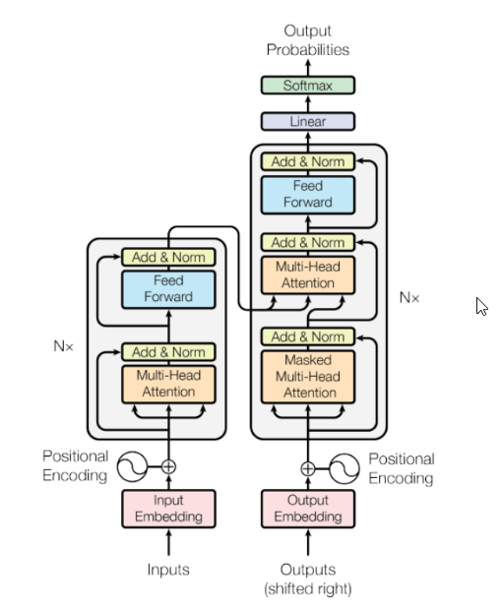
Output Probabilities
Encoder
Decoder
Inputs
Outputs

Slide 2
